Slide 1

Name : Kethamreddy Punith reddy
SkillBuild Email ID : kethamreddypunithreddy@gmail.com
AICTE Email ID : kethamreddypunithreddy@gmail.com
Organization : DGT
College Name : Sri Venkateswara College Of Engineering & Technology(Autonomous),Chittoor
College State : AndhraPradesh
Internship Domain : Data Analytics

Slide 2


PROBLEM STATEMENT
In this project, we analyze sales data from the SampleSuperstore dataset to gain insights into sales trends and factors affecting sales. We use data visualization techniques like bar charts and pie charts to understand sales patterns based on regions, customer segments, and product categories. Additionally, we build a Linear Regression model to predict sales based on features like quantity, discount, and profit. The goal is to discover valuable information that can help improve business strategies and maximize profitability in the superstore.

Slide 3
AGENDA
Introduction to the Project- Analysis of Superstore Dataset
Project Overview- Purpose, Scope and Objective
End Users
Solution and Value Proposition
Customization of the Project & Code Snippets
Modelling & Insights
Results of Analysis - Key Insights, Actionable Insights, Customized Solutions
Relevant Links

Slide 4


Project Overview:
Superstore Data Analysis
Purpose:
To analyze the Superstore dataset and gain valuable insights into the store's performance, customer behavior, and sales trends.
Scope:Exploratory Data Analysis (EDA), Sales Analysis, Customer Segmentation, Product Category Insights, and Profitability Analysis.
Goals:
1. Uncover Key Business Insights: Identify critical factors influencing sales and profitability.

Slide 5

Project Overview:
Superstore Data Analysis
2.Optimize Sales and Marketing Strategies: Tailor efforts for increased revenue.
3.Improve Operational Efficiency: Identify inefficiencies in supply chain management.
4. Enhance Customer Experience: Understand customer preferences and enhance satisfaction.
Tools Used:
Python, Pandas, Matplotlib, Seaborn, Jupyter Notebook.
This analysis will provide actionable insights to optimize business strategies, enhance operational efficiency, and achieve sustainable growth in the competitive retail market.

Slide 6


END USERS
Business Managers: Make informed decisions, optimize strategies for increased profitability.
Marketing Teams: Create targeted campaigns based on customer segmentation insights.
Sales Teams: Plan sales strategies, forecast demand, and focus on top-performing products.
Supply Chain & Inventory Management: Optimize operations, manage inventory levels efficiently.

Slide 7
END USERS
Finance Teams: Gain insights into profitability, assess financial implications of decisions.
Business Analysts & Data Scientists: Improve analytical models and methodologies.
Top Management & Stakeholders: Align business goals and strategies based on project findings.
Customer Service: Understand customer preferences and buying behavior to enhance customer service and tailor personalized experiences.

Slide 8
Solution and Value Proposition for Superstore Data Analysis
SOLUTION:
The solution to the problem statement involves conducting a comprehensive data analysis of the Superstore dataset to extract valuable insights and patterns. This will be achieved through various data exploration and analytical techniques, including Exploratory Data Analysis (EDA), sales trend analysis, customer segmentation, product category insights, and profitability analysis. Python programming, along with libraries such as Pandas, Matplotlib, Seaborn, and Scikit-learn, will be used to manipulate and analyze the data effectively.
ValueProposition:
Data-Driven Decisions: Equips business managers with data-driven insights for optimized strategies and sales forecasting.
Enhanced Customer Experience: Tailors services based on customer preferences, improving satisfaction and loyalty.

Slide 9
3.Optimized Inventory Management: Minimizes stockouts and overstocking, leading to cost savings and efficient supply chain management.
4.Increased Profitability: Identifies factors impacting profitability, enabling better financial planning and resource allocation.
5.Strategic Alignment: Aligns top management and stakeholders with data insights to drive business growth.
6.Competitive Advantage: Provides insights into growth opportunities, operations optimization, and customer experience, giving a competitive edge.
In conclusion, the Superstore Data Analysis project's solution and value proposition lie in its ability to provide actionable insights, optimize operations, and foster data-driven decision-making across various aspects of the business. The project's outcomes will lead to enhanced business performance, increased profitability, and a stronger position in the competitive retail landscape.

Slide 10
Customization of Project & Code Snippets
Data Source: Customize the project by using your own dataset or data from a different domain. Ensure the data is relevant to the objectives and scope of the analysis.
Additional Features: Include additional relevant features to improve the model's predictive capabilities. For example, you can consider customer demographics, seasonality, or marketing campaign data.
Visualization: Customize data visualizations to showcase specific insights effectively. Use various charts, graphs, and plots to present the analysis visually.
Machine Learning Models: Explore and implement different machine learning algorithms beyond linear regression.
Hyperparameter Tuning: Optimize machine learning models by performing hyperparameter tuning to achieve better results.
Advanced Analytics: Incorporate advanced analytics techniques, such as clustering or time-series forecasting, to gain deeper insights from the data.
Business Domain Context: Provide context and explanations for insights and results based on the specific domain of the superstore business.

Slide 11
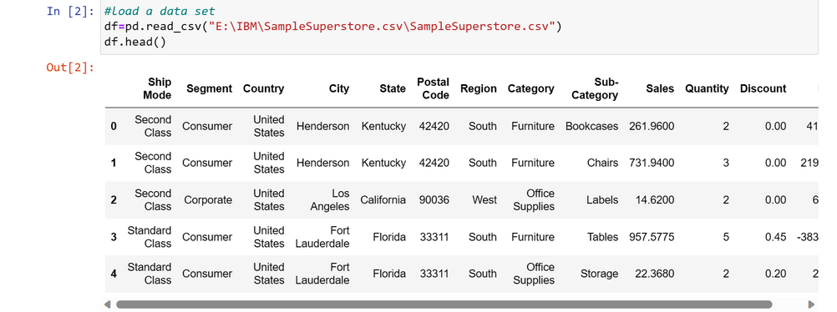
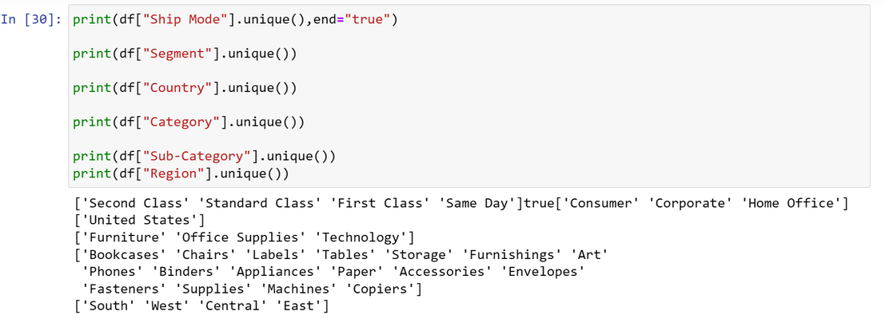
CUSTOMIZATION OF PROJECT & CODE SNIPPETS
Data Loading: The Superstore dataset is loaded using Pandas, and the first few rows are displayed using df.head() to get a quick look at the data.
Data Cleaning: The "Postal Code" column, which is not relevant to the analysis, is dropped from the DataFrame using df.drop(columns="Postal Code", inplace=True).
Data Exploration: Unique values of categorical columns like "Ship Mode," "Segment," "Country," "Category," "Sub-Category," and "Region" are displayed using df["Column_Name"].unique().

Slide 12
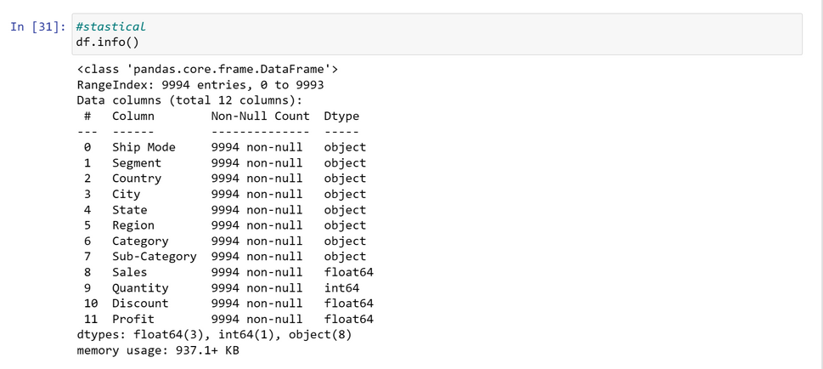
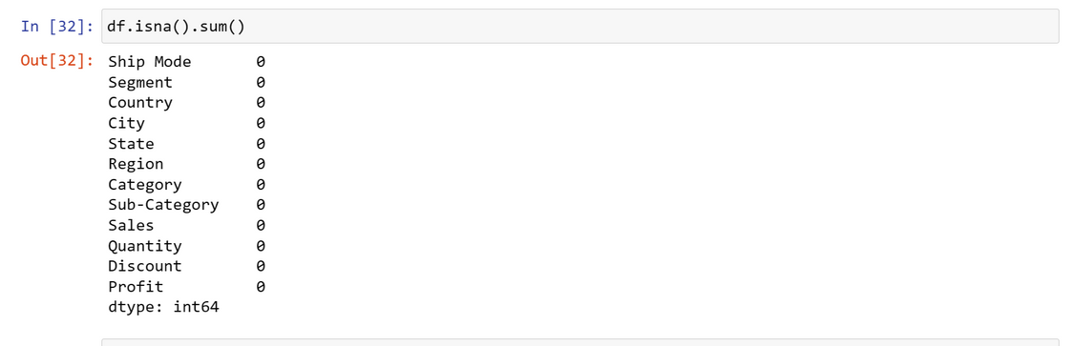
CUSTOMIZATION OF PROJECT & CODE SNIPPETS
4.Statistical Information: The df.info() function displays essential information about the DataFrame, including column names, data types, and memory usage.
5.Checking for Missing Values: The df.isna().sum() function is used to check for any missing values in the dataset. In this case, there are no missing values.

Slide 13
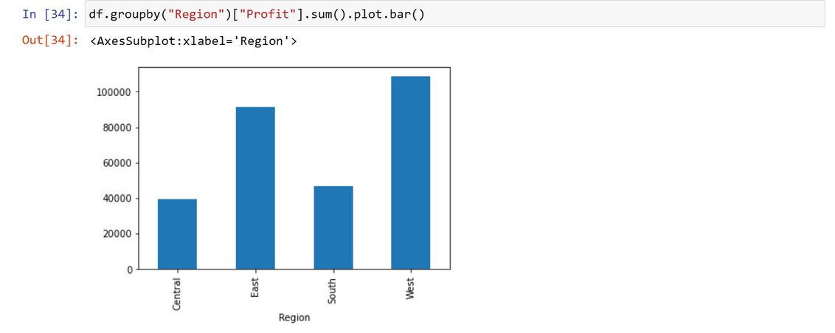
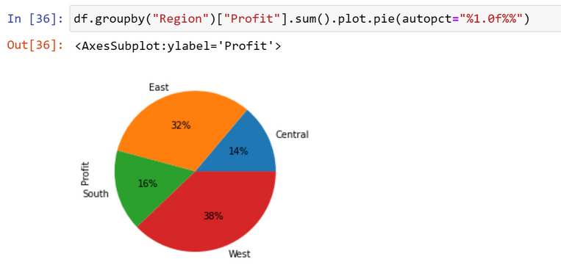
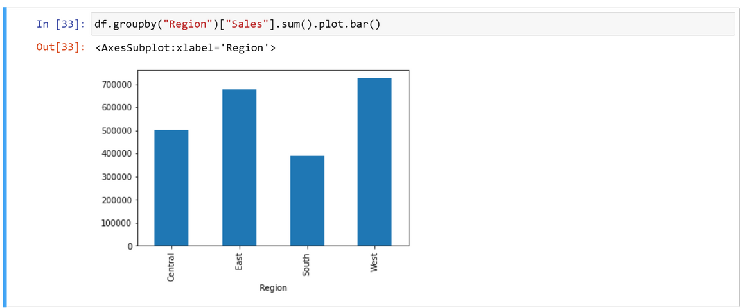
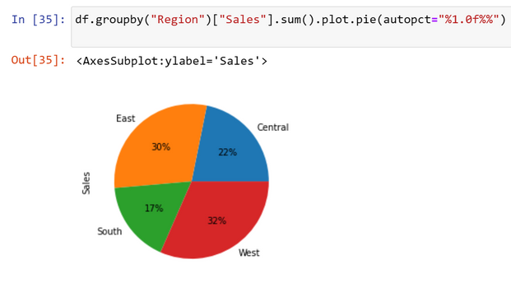
MODELLING AND INSIGHTS
Sales and Profit by Region:
The bar charts display the total sales and profit for each region. "South" region has the highest sales and profit, while "West" region follows closely.
The pie charts represent the sales and profit distribution across regions as percentages, showing the relative contribution of each region to the overall sales and profit.

Slide 14
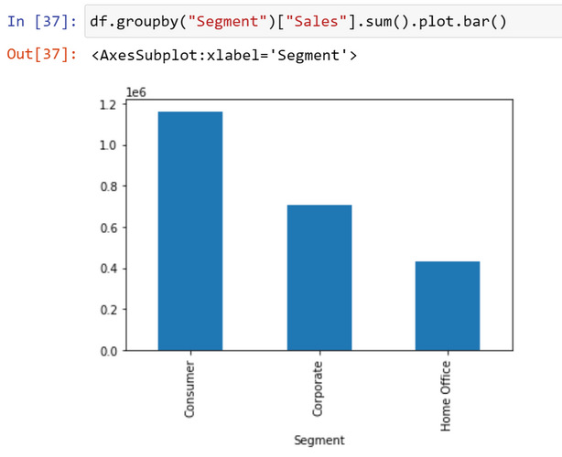
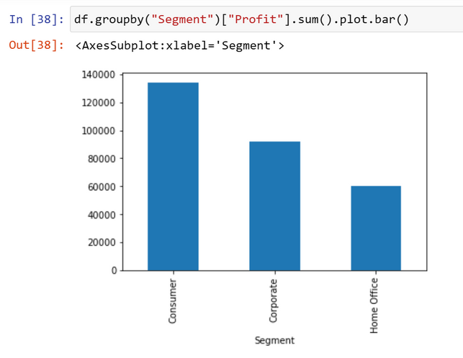
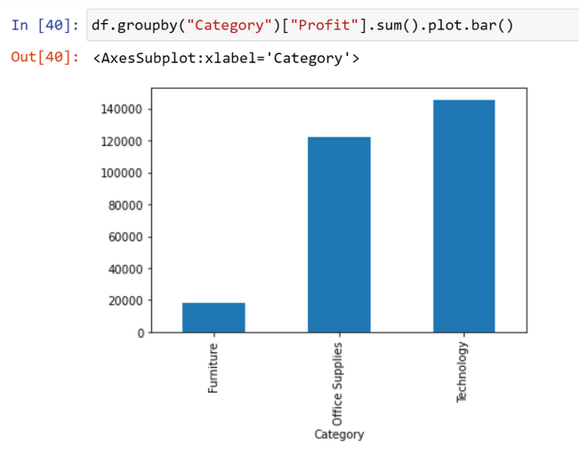
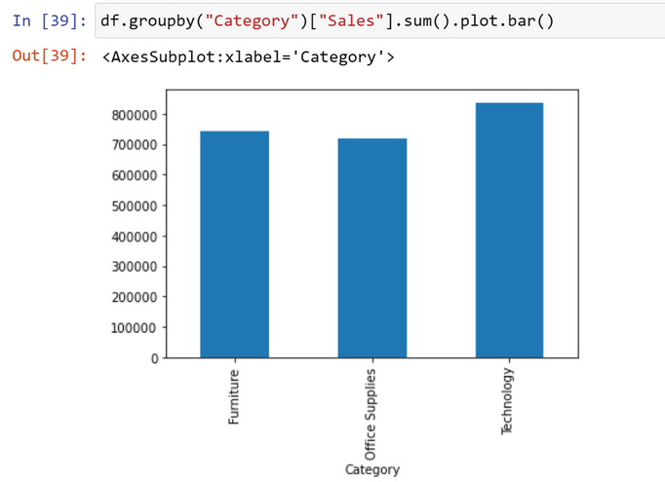
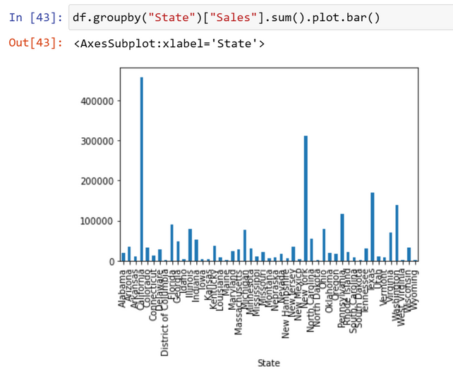
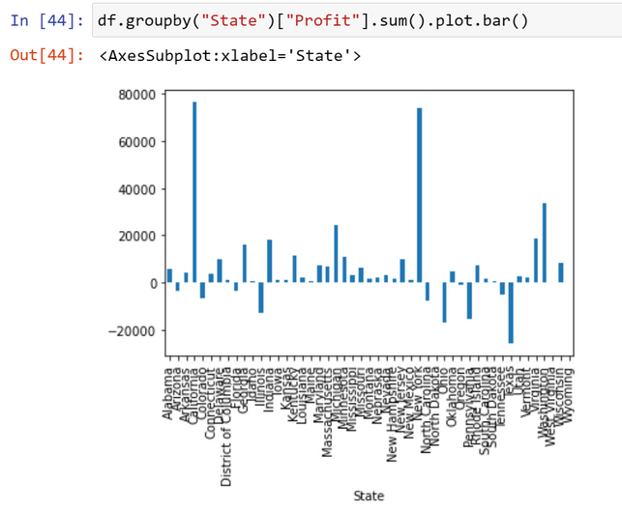
MODELLING AND INSIGHTS
Sales and Profit by Segment
Sales and Profit by Category
Sales and Profit by State

Slide 15
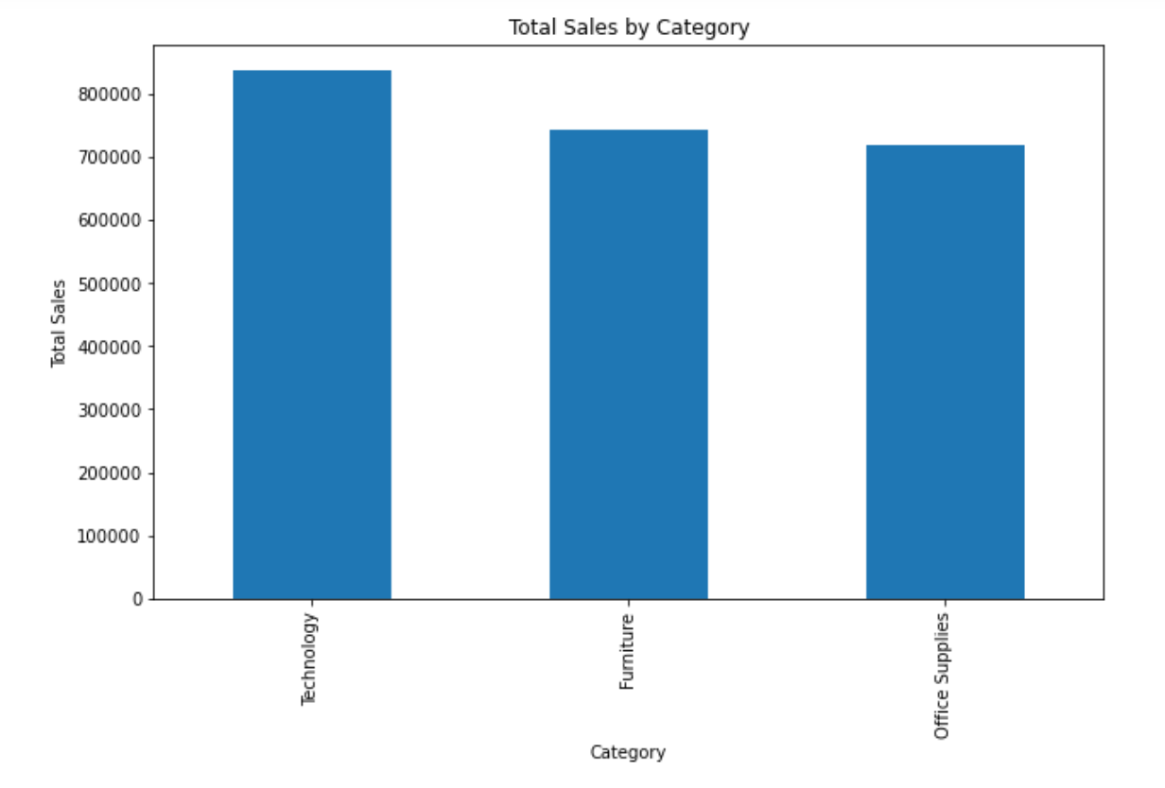
MODELLING AND INSIGHTS
Total Sales by Category:
The bar chart presents the total sales for each category in descending order. "Technology" category dominates in terms of sales, followed by "Furniture" and "Office Supplies."

Slide 16
INSIGHTS
The "South" region stands out with the highest sales and profit, indicating it is a lucrative market for the Superstore.
The "Consumer" segment drives the majority of sales and profit, suggesting a strong focus on consumer-centric strategies.
The "Technology" category shows the highest sales and profit, highlighting its significance in driving overall revenue.
Certain states, such as "California" and "New York," contribute significantly to the Superstore's sales and profitability.
The visualizations provide a clear overview of performance across different dimensions, enabling data-driven decision-making and targeted strategies.

Slide 17
Results: Superstore Data Analysis
Sales and Profit Analysis by Region:
The "South" region leads in both total sales and profit, indicating that it is the most lucrative market for the Superstore.
The "West" region closely follows with substantial sales and profit, suggesting it is also a key region for business growth.
Sales and Profit Analysis by Segment:
The "Consumer" segment accounts for the highest total sales and profit, signifying its significance in driving revenue.
The "Corporate" segment also contributes significantly to sales and profit, while the "Home Office" segment lags behind in comparison.
Sales and Profit Analysis by Category:
The "Technology" category dominates in terms of both total sales and profit, indicating its importance in the Superstore's revenue generation.
The "Furniture" category follows with notable sales and profit, while the "Office Supplies" category contributes significantly as well.

Slide 18
4.Sales and Profit Analysis by State:
States like "California" and "New York" stand out as major contributors to the Superstore's sales and profit.
Some states exhibit relatively lower sales and profit figures, indicating potential areas for improvement and targeted strategies.
5.Total Sales by Category:
The "Technology" category emerges as the top-performing category, significantly contributing to the Superstore's overall sales.
"Furniture" and "Office Supplies" categories also showcase substantial sales, making them crucial revenue drivers

Slide 19
Key Insights:
The "South" region and the "Consumer" segment are the primary revenue drivers, suggesting a strong customer base and successful marketing efforts in this region and segment.
The "Technology" category has a substantial impact on the Superstore's revenue and profitability, indicating its popularity among customers.
Focusing on states like "California" and "New York" can lead to further sales growth and profit optimization.
There may be opportunities to enhance sales and profit in states with relatively lower figures, through targeted marketing or localized strategies.
The Superstore should prioritize investments and marketing efforts in product categories like "Technology" and "Furniture" to maximize revenue.

Slide 20
Recommendatios:
Regional Expansion: Explore opportunities for expanding operations in the "West" region to capitalize on its potential for growth.
Customer Segmentation: Tailor marketing strategies based on the "Consumer" segment's preferences to improve customer satisfaction and loyalty.
Product Focus: Continue to invest in the "Technology" category while also strengthening the "Furniture" category to drive overall sales.
State-Level Strategies: Implement state-specific strategies in regions with lower sales and profit to boost performance.
Operational Efficiency: Analyze internal processes and supply chain efficiency to optimize costs and enhance overall profitability.

Slide 21
GitHub Riposotory Link:
https://github.com/punith333/superstore-data-analysis

Slide 22
THANK YOU
IBM SKILLBUILD
EDUNET FOUNDATION

